Slide 1
Webinar will begin shortly
November 25, 2020
Notes:
MARC:
5 min prior to webinar:
Good afternoon, we will begin the webinar in five minutes.
At this point, you should see the title slide on your screen, and you should hear my voice.
If I’m too quiet or too loud on your end, or if you aren’t logged in to the webinar app, now is a great time to make those adjustments.
1 min prior:
Good afternoon everyone, several people are still logging in, so we will wait one more minute and then begin.

Slide 2
Webinar – Nov. 25, 2020
Steve MacDonald - CEO
Marc Huot – Program Director
Notes:
MARC:
@ start:
Good morning and thank you for joining our webinar on ERA’s Energy Savings for Business Program.
We’re glad you could join us so we can share this great opportunity with you.
We believe the program can help your company save on the bottom line, increase the value of your buildings, create jobs in Alberta and make a real difference in GHG reductions in Alberta. Hopefully today’s discussion can help you prepare to take full advantage of the program when it launches.

Slide 3
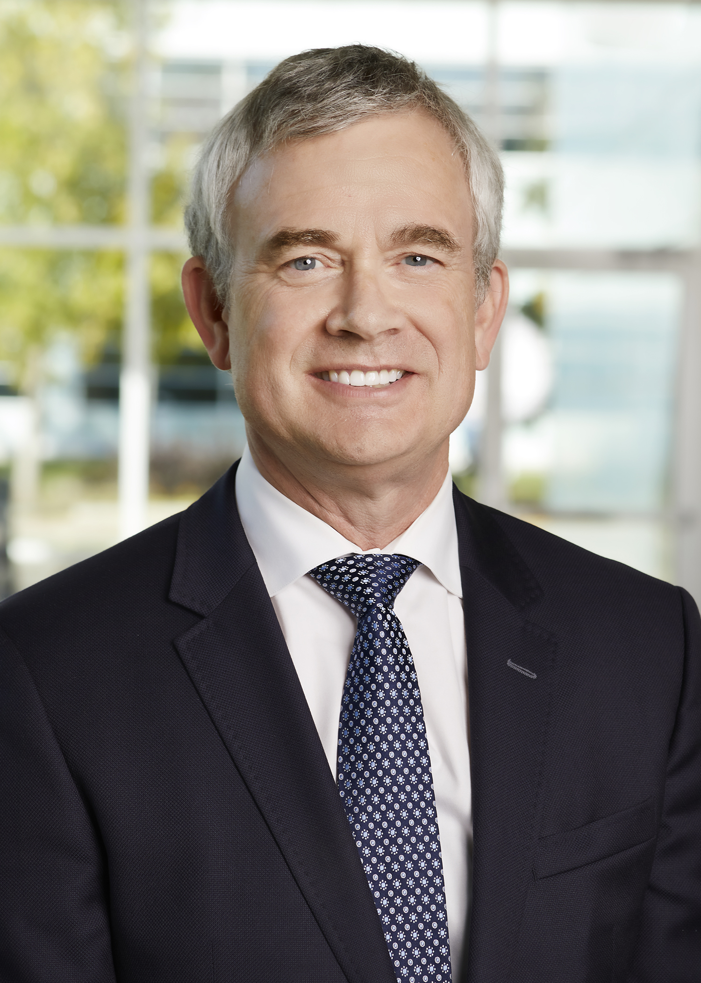

Speaker Introductions
Steve MacDonald
Chief Executive Officer
Marc Huot
Program Director
Notes:
MARC:
My name is Marc Huot, I am the Program Director of the Energy Savings for Business Program for Emissions Reduction Alberta, or ERA.
STEVE:
And I’m Steve MacDonald, the CEO for ERA.
Hello everyone, thank you for joining us.
MARC:
Steve and I will be trading off back and forth today as we talk about our recently announced Energy Savings for Business Program.
And we’ll both be here after the presentation to answer questions during the Q&A period.

Slide 4
Housekeeping
Microphones are muted​
If you called in, select “telephone” and enter audio PIN​
Type questions into the “Questions” section of the control panel​
  We will try to answer as many questions as possible
If you have technical difficulty during the webinar, it is being recorded and will be posted on our website
Notes:
MARC:
Before we get into the agenda, I’d like to start by going through a few housekeeping items, just to make sure we get the most out of our time today.
First of all, we’re expecting over 400 participants today, so everyone’s microphone is muted to avoid unintentional background noise.
If you encounter technical challenges related to the Webinar connection, please email Amanda at info@eralberta.ca and we will try to help if we can.
However, if you can’t resolve your technical issues, or if you need to leave early, we will be posting a recording of this webinar on the Energy Savings for Business Program website page
The recording will include both the presentation and the live Q&A, with audio.

Slide 5
Agenda
About Emissions Reduction Alberta (ERA)
Energy Savings for Business (ESB) Program overview
  Program overview and scope
  Anticipated benefits
  Eligibility – participant and contractor
  Project Types/Measures
  Application Process
  Timelines
Q&A
Next steps
Notes:
MARC:
In terms of an agenda for today’s webinar, we plan to cover a few items that will hopefully be helpful for everyone on the line.
First, Steve will talk briefly about ERA and our mandate.
Next, we’ll provide an overview of the Energy Savings for Business Program.
We’ll cover some key points about the program, including:
- eligibility, – project and measure types, – the application process, and program timelines
We’ll also provide some advice for anyone that’s interested in making a submission.
And, finally, we’ll end off by answering some of your questions.
So, if you have any questions, please type them into the “Questions” section of the GoToWebinar control panel.
We will answer as many as we can, but, if we don’t address your question, you’re welcome to follow-up with us afterward.
With that, it is my pleasure to turn things over to our CEO, Steve MacDonald, who will get things started with an overview of ERA.

Slide 6
Up to $280 million in new ERA funding announced
Supports 5,000 jobs
Reduces 13 million tonnes of emissions
Includes three programs:
  $55 million Energy Savings for Business program
  $150 million Shovel-Ready Challenge
  $75 million for existing Partnership Intake Program
Notes:
STEVE:
Thank you, Marc.
At the beginning of the month, Premier Jason Kenney and Minister Jason Nixon announced a commitment of up to $280 million for three ERA programs.
This funding includes up to $180 million in TIER funding from the province, and $100 million from the federal government's Low Carbon Economy Leadership Fund (LCELF).
And… as is always the case with ERA… it will be leveraged even further by other public and private dollars, leading to projects valued at approximately $900 million.
It’s our expectation that these programs will result in around 5,000 jobs and cut an estimated 13 million tonnes of emissions…
Today we will focus on the $55 million for our new Energy Savings for Business program… this program demonstrates the value the provincial government places on energy efficiency as a lever to reduce emissions and provide economic stimulus to small and medium sized businesses
But… I want to acknowledge this $280 million in funding also includes up to $150 million for our Shovel-Ready Challenge
And… it includes a $75 million boost to our existing Partnership Intake Program.
This commitment of both provincial and federal funding will help unlock the development and deployment of the technologies we need to stimulate the economy now and create the lower-emissions industries of the future.

Slide 7
Stimulus funding in Alberta
 | ERA Energy Savings for Business | ERA Shovel Ready | Alberta Innovates TIER Economic Recovery Program | Carbon Connect International Methane Technology Implementation Program
Focus Area | Small- and medium-sized businesses | Large-scale, shovel ready | Shovel-Ready Energy & Cleantech | Upstream oil and gas operator retrofits
TRL | Technology commercialization | 7-9 | 4-7 | Technology commercialization
Funding Source | TIER & LCELF | TIER & LCELF | TIER | TIER
Total Program Funding | $55M | $150M | $50M | $25M
Funding amount per project | $250K per project $500K per company | $2M - $15M | $200K - $5M | $10K - $1M
Funding % | Measure dependent | 50% | 75% | 50%
Proposals Due | 6-12 months after program launch | Stage 1: Dec 22, 2020 Stage 2: Mar 2021 | Stage 1: Nov 16, 2020 Stage 2: Nov 30, 2020
Notes:
I know there have been a lot of funding announcements lately.
We know many companies have limited resources to respond to these Calls for Proposals and new programs.
I want to assure everyone we are working closely with our colleagues at Alberta Innovates, Alberta Environment and Parks and other ministries to make sure there is clarity and alignment between all the programs available.
We are designing a process that is respectful of the challenges you are facing – we are building on the foundation of work done by Energy Efficiency Alberta – and we are applying learnings from their programs to streamline the process, lessen the administrative burden and ensure more funding goes directly to participants.
Energy efficiency initiatives have the potential to significantly reduce GHG emissions. Research by Efficiency Canada indicates energy efficiency has the potential to help meet over 30% of Canada’s future emissions reduction targets. An analysis published by Corporate Knights indicates emissions from commercial buildings could be reduced by as much as 50% with aggressive energy efficiency retrofits.
As you may know… uptake of EEA’s programs was significantly higher than similar programs in other jurisdictions. Alberta gets it.
The latest energy efficiency potential study for Alberta identified over $11 billion of cost-effective energy efficiency upgrades over a 20-year period with the majority of this potential occurring in the industrial and commercial sectors within the province.
While current economic conditions are expected to impact market demand, we believe Energy Savings for Business can help to increase the uptake potential for new technology adoption.
Energy efficiency initiatives have the potential to significantly reduce GHG emissions. Research by Efficiency Canada indicates energy efficiency has the potential to help meet over 30% of Canada’s future emissions reduction targets. A recent analysis published by Corporate Knights indicates emissions from commercial buildings could be reduced by as much as 50% with aggressive energy efficiency retrofits. [**** REPEATED*** REMOVE?]
We did ask a few of EEA’s team members to join ERA… to maximize our learning and deliver the best new program to support Alberta’s energy efficiency opportunity.
We will work together to ensure that we are maximizing the value of these pools of money and minimizing the complexity for applicants.
Marc will share more details on this a bit later.

Slide 8

About ERA
MANDATE
VISION
Reduce GHG emissions and grow Alberta’s economy by accelerating the development and adoption of innovative technology solutions.
Alberta has competitive industries that deliver sustainable environmental outcomes, attract investment, and are building a diversified, lower carbon economy.
STRATEGIC PRIORITIES
1
ACCELERATE
TECHNOLOGY
2
DRIVE
COMMERCIALIZATION
3
MAXIMIZE
IMPACT
Notes:
STEVE:
We may have some people on the call today who are new to Emissions Reduction Alberta
ERA has a proven track record of fulfilling the vision, mandate and strategic priorities that you see on this slide.
When the Premier announced our funding on November 2nd, he made it clear that businesses must demonstrate they are serious about improving their environmental performance and lowering emissions if they want access to capital.
ERA investments ensure Alberta has competitive businesses that deliver sustainable environmental outcomes, attract investment, create jobs and grow our GDP.
Our vision is anchored in the belief that our success is measured in both economic and environmental terms.
We fondly refer to this as our “the genius of and” vision. The two outcomes are not mutually exclusive.

Slide 9




Areas of focus
Notes:
STEVE:
And our portfolio reflects this.
It aligns with both Alberta’s economic and environmental priorities.
And the projects span all sectors and timescales.
These investments are guided by our Technology Roadmap, which defines the pathways and areas of focus for ERA’s funding portfolio.
We regularly review this document to ensure we are being responsive to the changing needs of the province’s industries, innovators and investors.
2020 has taught us things can change quickly, so we invest a lot of time speaking to project partners to keep our finger on the pulse of how industry and business are being impacted by current economic and health conditions.
Our roadmap defines four areas of focus:
Cleaner oil and gas
Low emitting electricity supply and demand; so you can see, energy efficiency is not a new space for us. We have been focused on large scale industry for years. And now we have an opportunity to do more to accelerate technology adoption among small and medium enterprise.
Food, fibre and bioindustries , and
Low carbon industrial processes and products.

Slide 10
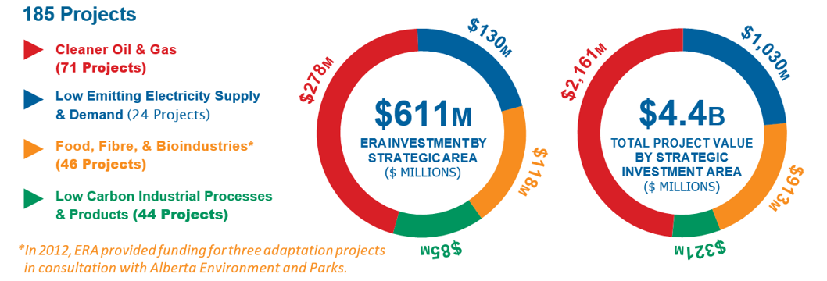
ERA investments
Notes:
STEVE:
We know that significant investments are required to identify and scale up the innovation that will ensure Alberta succeeds in a lower emissions world.
At ERA, our role is to help de-risk the most promising technologies, the ones that are closest to commercial deployment.
In the case of Energy Savings for Business...we are also working to accelerate the adoption of targeted commercially available energy-efficient technologies.
Since 2009, we have committed $611 million to support 185 projects valued at $4.4 billion.
The large project value reflects our ability to leverage more than 6:1 funding from project partners.
These investments will also lead to the creation of the equivalent of almost 22,000 person-year jobs by 2024 in Alberta…and contribute over $3 billion to Alberta’s GDP.
And… we are on track to deliver cumulative GHG reductions of almost 35 million tonnes by 2030.
This good work must continue.

Slide 11
Program Overview
Notes:
Marc:
Thank you Steve
Before I being, it is important to note that the Energy Savings for Business program (or ESB for short), is still in the design phase.
Today, I’ll be going through the core program information, but please note that some of the finer details are still being finalized.
All final program information will be made available at or before the program launches at the end of January.

Slide 12
Up to $55 million in new funding
$30 million from provincial TIER funds + $25 million from the federal Low Carbon Economy Leadership Fund (LCELF)
Aimed at small and medium industrial and commercial facilities
Notes:
MARC:
Diving straight into the program overview, we are excited to have received $55 million in funding from the provincial and federal governments to support cost-saving and emissions reducing projects in Alberta.
This will make ESB one of the single biggest energy efficiency program budgets for small and medium businesses we’ve had in the province to date
This funding is sourced from a combination of
the carbon price paid by Large Emitters in Alberta through the Technology Innovation and Emissions Reduction (TIER) fund in Alberta
and the federal Low Carbon Economy Leadership Fund
As the name Energy Savings for Business suggests, this program will be aimed at small-and-medium-scale industrial and commercial facilities in the province
We are hoping to get these funds driving new as soon as possible when the program opens to applications.

Slide 13
ESB program objectives
The Program will offer incentives to small and medium-scale industrial and commercial projects that can be deployed quickly to:
  Create and preserve jobs
  Generate energy cost savings
  Stimulate the economy
  Reduce GHG emissions
Create skilled jobs
Increase business competitiveness
Boost economic recovery
Lower carbon future
Notes:
MARC:
As a part of Alberta’s economic recovery plan, we designed the Energy Savings for Business program with four core purposes in mind.
By offering incentives for businesses to take on energy efficiency projects, ESB will result in job creation and the preservation of jobs in the energy efficiency product and service provider sector.
The energy savings benefits of the projects will drive operational efficiencies and reduce energy costs, making participating businesses more competitive.
This in turn will help to boost our economy and support our province’ economic recovery.
Finally, we’re going to do all this while supporting technologies and projects that reduce greenhouse gas emissions and address Alberta’s longer-term sustainability goals.

Slide 14

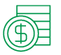

Anticipated benefits
Provincial investment leveraged >5 times with public and private investment
>160,000 small- and medium-sized enterprises
5X
>1,400 local jobs
$300M GDP Impact/ Economic Activity
1.1 Mt Co₂ lifetime GHG reductions
$183M Energy Savings over lifetime
Notes:
MARC:
Looking at the numbers, Alberta has over 160,000 small- and medium-sized enterprises and we’re hoping to reach thousands with this program.
As the ESB program rolls out, we’re anticipating achieving the following results:
Over 1,400 local jobs will be supported as participating projects rely on local contractors and a skilled workforce. This means direct jobs such as electricians, HVAC technicians, plumbing and heating experts, equipment distributors, lighting installers, product suppliers, engineers, and others..
Provincial investment will be leveraged more than five times with other public and private investment, creating 300M dollars in GDP impacts and economic activity.
Over their lifetime, projects supported through the program are expected to reduce GHG emissions by 1.1 Mt CO2 equivalent and to generate $183M in energy savings
With that, I’m not going to dive into some of the program details.

Slide 15
Program overview
Up to $250,000 available per project to a maximum of $500,000 per company
Open to new applications continually: first come, first served
Pre-approval funding reservations with incentive paid at completion
Prescriptive rebate for present measures (e.g. $ / unit)
Incentives will vary, designed to be between 15 to 30% of average costs
Pre-set list of eligible measures
Notes:
The Energy Savings for Business program will provide financial incentives to participants who install energy efficiency upgrades and on-site energy generation projects in their facilities.
As we designed the program, we considered the needs of small and medium businesses and built on our past program experience to make ESB as effective as possible.
For those of you who have participated in Energy Efficiency Alberta programs in the past, much of the program mechanics will be familiar and straight forward.
First, the program will offer up to $250,000 per project to a maximum of $500,000 per company, … ensuring funds are available to a wide range of companies across the province
We’re going to be keeping the program open to applications continually until the program budget is fully allocated, and
we will be processing applications on a first come first serve basis
The application process will include an up-front preapproval to screen projects for eligibility prior to the project installation.
Once pre-approved, funds for the project’s incentives are reserved and held until the project is complete.
This gives businesses the reassurance, confidence, and time needed to proceed with equipment purchase and installation
To keep things simple and easy for small businesses, we’ve chosen a prescriptive program approach
This means we have pre-set incentive levels for a specific list of eligible measures (or technologies)
This predictability allows you to plan ahead, know what’s eligible, what incentive levels to expect, and significantly reduces paperwork!
Incentive level are being designed to achieve the best results for each technology type and will vary measure to measure,
in most cases incentives will be approximately 15-30% of average costs

Slide 16
Project types/measures
(to be finalized)
Typical projects include commercially available energy-efficient upgrades such as:
  Boilers and heaters: e.g. condensing boilers and hot water heater, high-efficiency furnaces
  HVAC projects such as energy recovery ventilators, roof top units, pipe and duct insulation
  Motors and drives, including upgrades to fan and pump motors, including variable frequency drives
  Compressed air: air compressor system improvements and leak repairs
  Building envelope: upgrades to insulation & windows and air infiltration reduction measures
Notes:
MARC:
To make the program as accessible as possible to different businesses and facility types, we’ve built on past programs to offer incentives for a wide range of common technologies and upgrades. We are selecting measures that best:
reduce a facility’s energy use below business as usual levels,
offer strong energy savings to the participants,
drive cost-effective greenhouse gas emissions reductions, and
are proven, well understood, and suitable to our streamlined prescriptive process.
The final measure list will be available at program launch, but to give you a sense of what to expect, we are considering a range of measures in the following categories:
High efficiency boilers, heaters, and furnaces
A variety of HVAC projects types
Motors upgrades and variable frequency drives
Compressed air system improvements and leak repairs
Building envelope retrofits

Slide 17
Project types/measures continued
(to be finalized)
Typical projects include commercially available energy-efficient upgrades such as:
  Lighting systems & lighting controls: a wide range of high-performing lighting system upgrades and common lighting control systems (daylight and occupancy)
  Process heat efficiency upgrades, e.g. burner controls, heat recovery economizers, steam trap retrofits
  Power management: installation of electronic building automation systems, computer power management, etc
  A range of sector-specific measures for restaurants, hospitality, and refrigeration facilities
  Alternate on-site power sources such as solar photovoltaic systems (microgeneration) and CHP (microgeneration)
Notes:
MARC:
Lighting systems & lighting controls,
Process heat efficiency upgrades
Power management and building automation systems
A range of sector-specific measures for restaurants, hospitality, and refrigeration facilities
And, alternate on-site power sources, such as solar PV systems and combined heat and power
Being more complex projects, solar PV and CHP projects will have to meet additional requirements
For example, solar projects must be compliant with Alberta’s microgeneration regulation
Both system types will have to meet minimum performance parameters, and
system sizes will likely be limited to 1.5MW of capacity for both CHP and solar

Slide 18
Eligible participants
This program is open to all industries and business types, including non-profit organizations, across Alberta
Projects must occur in facilities located within Alberta
Focus is small- and medium-scale businesses
Not eligible:
  Large Emitters and Opted-in facilities under the TIER regulation
  Federal, provincially, and municipally-owned buildings
  Publicly funded institutions (universities, schools, hospitals)
Notes:
MARC:
Now I would like to talk about WHO can participate in the Energy Savings for Business program.
As I mentioned earlier, the program is being designed for small and medium sized commercial and industrial facilities. So the program will be most suited to these participants. However, eligibility to participate will be much broader. ESB will be open to all businesses and non-profit organizations across Alberta, EXCEPT FOR the following:
Facilities participating in the TIER Regulation. This includes Large Emitters and facilities that have opted into TIER in the given year.
New construction projects will not be eligible with the exception of on-site power generation installations ,
federally-, provincially- and municipally-owned buildings,
other publicly funded institutional buildings,
And private residential spaces within commercial buildings,
Full eligibility criteria will be defined in the program’s terms and conditions at program launch.

Slide 19
Eligible contractors
Eligible Contractor – is a product or service provider that has agreed to and signed the Energy Savings for Business Contractor Code of Conduct
Participants must use an Eligible Contractor for their projects to be eligible
How to become an eligible contractor:
  Register on the website
  Agree to the Code of Conduct and Terms and Conditions
Notes:
MARC:
Contractors, including product and service providers, are the backbone of any successful energy efficiency program.
Participants will rely skilled local contractors to plan and design systems, select appropriate technologies, and install high-quality projects.
In many cases, contractors will often manage applications for participants as well.
To help ensure the program’s success, we do require that all participants use eligible contractors as their primary contractor for their projects.
However, we are designing our contractor onboarding process to be as easy and streamlined as possible.
To become an eligible contractor, product and service providers will need to register, and agree to a code of conduct and the program’s terms and conditions before participating.
Upon registration, we will provide basic training on the program rules, the application process, and any online portals or software used in the program
For contractors listening today, we encourage you to stay tuned – as we are aiming to begin accepting eligible contractors prior to program launch, so that folks are ready to go when ESB opens.

Slide 20
Application process
Program launch
  Complete details, including terms and conditions and a list of eligible projects will be available
Application portal opens – will be an electronic application
Two stage application
  Pre-approval – funding is reserved; first-come, first-served
  Completion approval
Once program launches, pre-approval will be required to begin construction and incur expenses.
Projects must meet the project timeline eligibility criteria in the Terms and Conditions
Notes:
MARC:
Next, I wanted to talk about how participants apply for ESB incentives when the program launches.
Recognizing that time is money to businesses, we’ve put a lot of thought into making the application process as streamlined as possible.
All applications will be managed through an easy-to-use online tool and the web forms will be simple and straight-forward to navigate.
The application process itself will be broken down into 2 core stages:
The first stage is the project pre-approval.
Early in the project life, applicants will submit a project for pre-approval at which time eligibility and scope will be reviewed.
Pre-approved projects will then have funds reserved and will be allotted a set period of time to complete the installation (for example, 6 months)
It’s important to note, once the program launches, all projects must receive pre-approval prior to incurring any eligible expenses
The second stage is the Completion approval
Once a project is installed and operational, participants will submit all required documentation for final review
Virtual or in-person site visits will be completed for a randomized sample of projects at this time
Projects that are approved as “complete” will then receive incentive payments

Slide 21
Participant application journey
Select a contractor
Contractor registers
Plan your project
Apply for pre-approval
Incentive payment
Review/ on-site audit (random)
Submit completion
Installation and permitting
Notes:
To make it more clear, this visual shows the typical flow of a participant through the program, (although individual processes may vary)
There may be some preliminary work not shown on this figure, but once a participant has a project in mind, the first step is typically to select a primary contractor.
If the contractor is new to the program, the contractor will then register. However, if they’re already an Eligible Contractor, this step can be skipped.
From there, the project is planned; including any system design and equipment selection. When the necessary details are finalized, the project can submitted for pre-approval.
The application will be reviewed, and if it meets the program requirements, a formal pre-approval will be issued along with a funding reservation.
At that time, the participant will be required to accept the program terms and conditions and can proceed to purchase and install all associated equipment as per the submission.
Once the project is completed and fully operational (including any permitting required outside of the program), all required completion documentation will be submitted for a completion review.
The program team will then conduct a completion review, including virtual or on-site inspections for a randomized sample of projects.
If everything checks out and was completed as approved, the project will receive a Completion Approval and incentive payments will be issued through electronic fund transfers.
… and with that, the project is complete!

Slide 22
Anticipated timelines
What | Timeline
Program Announcement | November 2, 2020
Expressions of Interest | Now until January 2021
Contractors register to be eligible | December 2020 – January 2022
Program Launch | Open to applications by Feb 1, 2020
Detailed webinars | January – February 2021
Application Period | 6-12 months after program launch
Notes:
This next slide covers timelines for some of the key program milestones.
As you likely already know, the program was announced formally on November 2nd, and from then until the program launch, we will be accepting expressions of interest on our webpage.
We know there is a lot of demand for this program and we hope the announcement motivated folks to start thinking about potential projects.
We will have the program open to accept applications by February 1, 2020, and we are working very hard behind the scenes to get the it launched even sooner if possible. We will provide any updates to timelines as we approach launch.
As I mentioned earlier, we’re also hoping to get started with contractor registration before the program launches.
Following the official program launch, we will be hosting additional webinars to walk through the application process in more detail, how to use the online portal, and to cover additional details for eligible contractor onboarding & contractor resources.
As I mentioned earlier, the program will remain open continuously for new project applications until the budget is fully allocated. How quickly this happens will really depend on the volume and complexity of applications we get, but we expect it to be open for 6-12 months following the program launch.
However, as this program reserves funding for incentives on a first-come, first-served basis, we recommend you get your applications in as soon as you can.

Slide 23
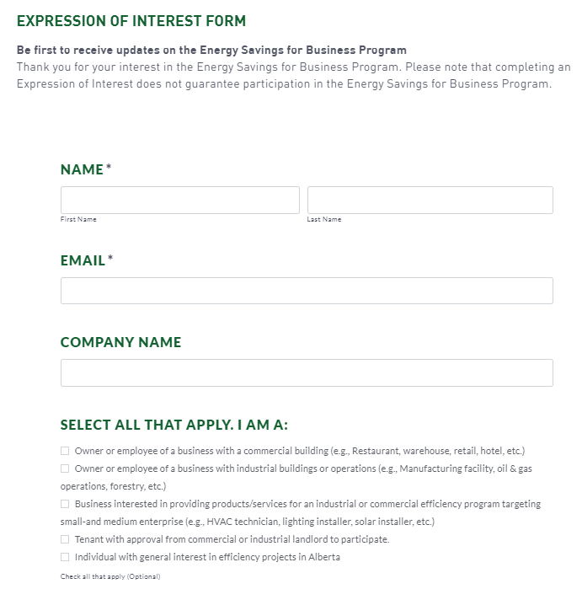

Be the first to know
Submit an Expression of Interest Form on the Energy Savings for Business Program page, on the ERALBERTA.ca website
Subscribe to ERA’s newsletter for general updates
Notes:
As we prepare to launch, we highly encourage interested businesses and contractors to submit an expression of interest. By doing so you will be placed on the program mailing list and this is the best way to receive updates and announcements related to the program. The form is quick to fill out and found at the bottom of the ESB webpage.
Just to be clear: submitting an expression of interested does not have any effect on your future applications, nor does it reserve funds in any way.
As mentioned, the program is still being finalized and we will have more information in the coming months. All participating projects will be subject to the program terms and conditions published at the time of application submission.
so please be aware that what we covered today may be subject to change up until the Terms and Conditions are published. I thank you for your patience as we finalize the details.

Slide 24
Frequently asked questions
How similar will this be to previous energy efficiency programs?
If I've started a project already, will I still be eligible for funding through this program?
What support will there be for contractors?
Will the program budget be divided into categories by measure or technology type?
If I have already applied for ERA funding, am I eligible?
Notes:
With the formal part of the webinar is complete. I wanted to start the question period by addressing some of the common questions we have been receiving since the program launched:
How similar will this be to previous energy efficiency programs?
For those of you who have previously participated in similar programs for example the Residential and Commercial Savings Program or Busines Energy Savings programs over the past few years, you will likely find the application process and requirements of the Energy Savings for Business to be quite similar. We are doing this deliberately to continue the momentum of contractor’s experience with those programs,. Further, we are fine tuning the new program, building on what we learned, and making it more effective for everyone involved.
If I've started a project already, will I still be eligible for funding through this program?
Recognizing that the program was announced on November 2nd, many of you will have projects that you wanted to get started on right away. As such, when the program launches, we will accept projects that started between November 2nd 2020 and the program launch date. To be eligible, these projects must submit applications for pre-approval within 30 days of program launch, they must meet all eligibility criteria as published at program launch, and all eligible expenses must be incurred after November 2.
What support will there be for contractors?
In addition to forthcoming webinars at program launch, we will also have educational resources and handy tools such as instructional videos available on a range of topics, including: how to submit applications, the rules of the program and a marketing toolkit specifically for contractors.
Will the program budget be divided into categories by measure or technology type?
We have been asked, for example if there will be a specific program budget allocation for solar projects or CHP projects. The answer, at this time, is no. We are designing the program such that all projects have equal access to the program funding on a first come first serve basis. However, we want to ensure a diversity of measures, so if we're seeing that one category of measures is taking over the program, we may implement further limits as needed. Any such changes would be well communicated at the time.
If I have already applied for ERA funding, am I eligible?
As the scope of the ESB program differs significantly from other ERA calls, we are allowing previous applicants to ERA programs to apply to Energy Savings for Business but only for new projects that have not previously been approved for funding.

Slide 25
Questions?
Please type your questions into the “Questions” pane of the control panel, which is typically on the right-hand side of your screen. ​
Notes:
MARC: ​
Alright, if you’ve made it this far, and if you’re still awake, this is your opportunity to ask any questions that you have for Steve and me. ​
If you haven’t already, please type your question into the “Questions” section of the control panel, which is typically on the right-hand side of your screen. ​
At this time, I would also like to introduce my colleague, Allison Mostowich, who will moderate the question period. Allison, our Manager of Engagement and Outreach, and Luca Jungen, our Program Manager have been behind the magic curtain of this webinar collecting the questions. Allison, what do we have for questions?
ALLISON:
Thanks Marc. And thank you to everyone who has submitted questions so far. We have a lot of great questions, and we likely won’t have time to get to them all today. If we don’t get to your question, please submit it to energysavings@erAlberta.ca and we’ll be happy to respond to you one-on-one. Please also note that we’ll be using your questions to inform our Frequently Asked Questions document, which will be released closer to launch.
Our first question is

Slide 26
Wrap up and next steps
Unanswered questions?​
Review the guidelines and supporting materials online, eralberta.ca ​
Email remaining questions to energysavings@eralberta.ca
This webinar will be posted on the ERA YouTube page.
Submit your Expression of Interest today on the ERA website.
Notes:
MARC:
With that, our webinar is drawing to a close. Please continue to visit our program website, which can be found by going to eralberta.ca, clicking on the “funding” tab, then scrolling down to the ESB section.
If you have unanswered questions following the webinar, as Allison said, please do not hesitate to reach out to our program team at enerysavings@ERalbeta.ca
And finally, please submit an expression of interest today to stay on top of all program updates.
[flip slides for thank you]

Slide 27
Thank You
Visit eralberta.ca for more information
Notes:
Thank you for your time and we look forward to working with you as this program proceeds.

